Slide 1

Targeting Technical Debt to speed up Development
Helen Wallace

Slide 2
Agenda
~10 minutes + questions
Why I did this? Should you do this?
How do you do it?
Pulling from VCS
Basics
Filtering
Advanced Joining With Static Code Analysis
What next?

Slide 3
Short Story
Murex
15 years of code
New and confused
Difficult to where to start
Competition

Slide 4
Do You Need targeted refactors?

Slide 5
Development Life Cycle
Bug Found
Spec
Coding
Review
Test
Deliver
Coding
Find Code
Understand Code
Ideas to fix
Code Fix
Write Test
Find Code
Understand Code

Slide 6


Slide 7
How to Target
Code Churn
Code Health
Code to Target

Slide 8

Code Maat
Adam Tornhill
“mine and analyze data from version-control systems”
github.com/adamtornhill/code-maat

Slide 9
Pull Commit info from GIT
Code Maat Magic
Look at your results

Slide 10

Running on Guava
git log --pretty=format:"[%h] %aN %ad %s" --date=short --numstat --after=2015-01-01 > git_log.log
java -jar code-maat-1.1.jar -l git_log.log -c git > guava_churn.csv
entity | n-authors | n-revs
guava/src/com/google/common/util/concurrent/Futures.java | 21 | 124
guava-tests/test/com/google/common/util/concurrent/FuturesTest.java | 19 | 86
guava/src/com/google/common/graph/Graphs.java | 11 | 83
guava/src/com/google/common/util/concurrent/AbstractFuture.java | 21 | 79
pom.xml | 21 | 77
guava/src/com/google/common/graph/Graph.java | 9 | 75
guava/src/com/google/common/graph/Network.java | 6 | 67
README.md | 14 | 60
guava/src/com/google/common/collect/Maps.java | 22 | 58
guava-tests/test/com/google/common/graph/GraphsTest.java | 5 | 55
android/pom.xml | 13 | 50
guava/src/com/google/common/collect/Sets.java | 16 | 49
guava/src/com/google/common/collect/ImmutableMap.java | 13 | 48
guava/src/com/google/common/net/MediaType.java | 23 | 47
guava/src/com/google/common/cache/LocalCache.java | 20 | 47
entity | n-authors | n-revs
guava/src/com/google/common/util/concurrent/Futures.java | 21 | 124
guava-tests/test/com/google/common/util/concurrent/FuturesTest.java | 19 | 86
guava/src/com/google/common/graph/Graphs.java | 11 | 83
guava/src/com/google/common/util/concurrent/AbstractFuture.java | 21 | 79
pom.xml | 21 | 77
guava/src/com/google/common/graph/Graph.java | 9 | 75
guava/src/com/google/common/graph/Network.java | 6 | 67
README.md | 14 | 60
guava/src/com/google/common/collect/Maps.java | 22 | 58
guava-tests/test/com/google/common/graph/GraphsTest.java | 5 | 55
android/pom.xml | 13 | 50
guava/src/com/google/common/collect/Sets.java | 16 | 49
guava/src/com/google/common/collect/ImmutableMap.java | 13 | 48
guava/src/com/google/common/net/MediaType.java | 23 | 47
guava/src/com/google/common/cache/LocalCache.java | 20 | 47

Slide 11
Pull Commit info from GIT
Code Maat Magic
Look at your results

Slide 12


Running on Guava – No Tests
git log --pretty=format:"[%h] %aN %ad %s" --date=short --numstat --after=2015-01-01
-- . ":(exclude)**/test/**" ":(exclude)**/pom.xml"
> git_log_no_tests.log
java -jar code-maat-1.1.jar -l git_log _no_tests.log -c git > guava_churn_no_tests.csv
entity | n-authors | n-revs
guava/src/com/google/common/util/concurrent/Futures.java | 21 | 124
guava/src/com/google/common/graph/Graphs.java | 11 | 83
guava/src/com/google/common/util/concurrent/AbstractFuture.java | 21 | 79
guava/src/com/google/common/graph/Graph.java | 9 | 75
guava/src/com/google/common/graph/Network.java | 6 | 67
README.md | 14 | 60
guava/src/com/google/common/collect/Maps.java | 22 | 58
guava/src/com/google/common/collect/Sets.java | 16 | 49
guava/src/com/google/common/collect/ImmutableMap.java | 13 | 48
guava/src/com/google/common/net/MediaType.java | 23 | 47
guava/src/com/google/common/cache/LocalCache.java | 20 | 47
guava/src/com/google/common/util/concurrent/MoreExecutors.java | 17 | 47
guava/src/com/google/common/collect/ImmutableSet.java | 15 | 45
guava/src/com/google/common/graph/ValueGraph.java | 7 | 45
guava/src/com/google/common/collect/Iterators.java | 13 | 43
entity | n-authors | n-revs
guava/src/com/google/common/util/concurrent/Futures.java | 21 | 124
guava/src/com/google/common/graph/Graphs.java | 11 | 83
guava/src/com/google/common/util/concurrent/AbstractFuture.java | 21 | 79
guava/src/com/google/common/graph/Graph.java | 9 | 75
guava/src/com/google/common/graph/Network.java | 6 | 67
README.md | 14 | 60
guava/src/com/google/common/collect/Maps.java | 22 | 58
guava/src/com/google/common/collect/Sets.java | 16 | 49
guava/src/com/google/common/collect/ImmutableMap.java | 13 | 48
guava/src/com/google/common/net/MediaType.java | 23 | 47
guava/src/com/google/common/cache/LocalCache.java | 20 | 47
guava/src/com/google/common/util/concurrent/MoreExecutors.java | 17 | 47
guava/src/com/google/common/collect/ImmutableSet.java | 15 | 45
guava/src/com/google/common/graph/ValueGraph.java | 7 | 45
guava/src/com/google/common/collect/Iterators.java | 13 | 43

Slide 13
Running on Guava – Just Bug Fixes
git log --pretty=format:"[%h] %aN %ad %s" --date=short --numstat --after=2015-01-01
-- . ":(exclude)**/test/**" ":(exclude)**/pom.xml"
--grep=" fix "
> git_log_just_bugs.log
java -jar code-maat-1.1.jar -l git_log _no_tests.log -c git > guava_churn_bugs.csv
entity | n-authors | n-revs
guava/src/com/google/common/graph/Graph.java | 2 | 5
guava/src/com/google/common/cache/LocalCache.java | 3 | 4
guava/src/com/google/common/collect/LinkedHashMultimap.java | 3 | 4
guava/src/com/google/common/collect/Tables.java | 3 | 3
guava/src/com/google/common/collect/Maps.java | 3 | 3
guava-testlib/src/com/google/common/collect/testing/Helpers.java | 3 | 3
guava/src/com/google/common/collect/Iterables.java | 3 | 3
guava/src/com/google/common/collect/Sets.java | 3 | 3
guava/src/com/google/common/graph/Network.java | 2 | 3
guava-testlib/src/com/google/common/collect/testing/AbstractIteratorTester.java | 2 | 3
guava/src/com/google/common/util/concurrent/AbstractFuture.java | 2 | 3
guava/src/com/google/common/graph/MutableGraph.java | 2 | 2
guava/src/com/google/common/collect/ImmutableTable.java | 2 | 2

Slide 14
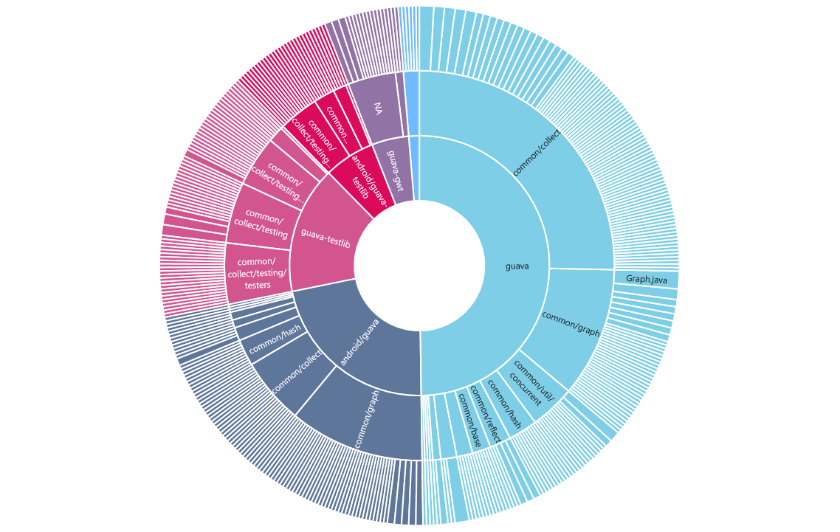
Big Picture Thinking
Packages vs Classes

Slide 15

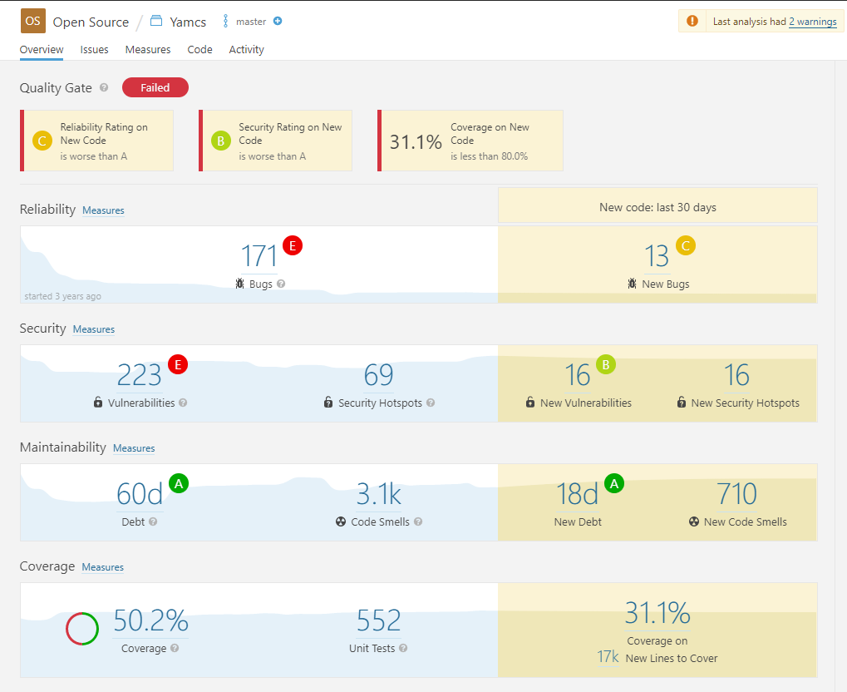
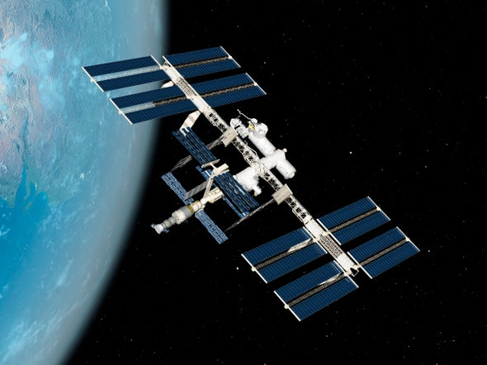

But the Boy Scout Rule!
Or what if someone already cleaned up this class?
https://www.yamcs.org/

Slide 16
YAMCS – Start Point
entity | n-authors | n-revs
yamcs-core/src/main/java/org/yamcs/YamcsServer.java | 4 | 141
yamcs-core/src/main/java/org/yamcs/xtce/SpreadsheetLoader.java | 3 | 85
yamcs-core/src/main/java/org/yamcs/management/ManagementService.java | 4 | 65
yamcs-core/src/main/java/org/yamcs/commanding/CommandQueueManager.java | 3 | 57
yamcs-core/src/main/java/org/yamcs/tctm/ReplayService.java | 3 | 53
yamcs-xtce/src/main/java/org/yamcs/xtce/xml/XtceStaxReader.java | 3 | 51
yamcs-core/src/main/java/org/yamcs/tctm/TcpTcDataLink.java | 4 | 46
yamcs-core/src/main/java/org/yamcs/xtceproc/XtceDbFactory.java | 2 | 46
yamcs-api/src/main/java/org/yamcs/YConfiguration.java | 3 | 45
yamcs-core/src/main/java/org/yamcs/parameter/ParameterWithIdRequestHelper.java | 3 | 41
yamcs-core/src/main/java/org/yamcs/algorithms/AlgorithmManager.java | 3 | 40
yamcs-core/src/main/java/org/yamcs/yarch/YarchDatabase.java | 2 | 40
yamcs-core/src/main/java/org/yamcs/commanding/CommandingManager.java | 3 | 38
yamcs-core/src/main/java/org/yamcs/archive/XtceTmRecorder.java | 3 | 38
yamcs-core/src/main/java/org/yamcs/YamcsServerInstance.java | 2 | 38
yamcs-core/src/main/java/org/yamcs/yarch/rocksdb/RdbStorageEngine.java | 2 | 38
yamcs-core/src/main/java/org/yamcs/web/HttpServer.java | 2 | 37

Slide 17
YAMCS – With Health Metrics
entity | n-authors | n-revs | coverage | issues
yamcs-core/src/main/java/org/yamcs/YamcsServer.java | 4 | 141 | 42.8 | 48
yamcs-core/src/main/java/org/yamcs/xtce/SpreadsheetLoader.java | 3 | 85 | 95.5 | 3
yamcs-core/src/main/java/org/yamcs/management/ManagementService.java | 4 | 65 | 70.1 | 8
yamcs-core/src/main/java/org/yamcs/commanding/CommandQueueManager.java | 3 | 57 | 52.5 | 15
yamcs-core/src/main/java/org/yamcs/tctm/ReplayService.java | 3 | 53 | 67.7 | 9
yamcs-xtce/src/main/java/org/yamcs/xtce/xml/XtceStaxReader.java | 3 | 51 | 73.5 | 78
yamcs-core/src/main/java/org/yamcs/tctm/TcpTcDataLink.java | 4 | 46 | 54.8 | 17
yamcs-core/src/main/java/org/yamcs/xtceproc/XtceDbFactory.java | 2 | 46 | 83 | 32
yamcs-api/src/main/java/org/yamcs/YConfiguration.java | 3 | 45 | 0 | 76
yamcs-core/src/main/java/org/yamcs/parameter/ParameterWithIdRequestHelper.java | 3 | 41 | 80.2 | 10
yamcs-core/src/main/java/org/yamcs/algorithms/AlgorithmManager.java | 3 | 40 | 72.5 | 5
yamcs-core/src/main/java/org/yamcs/yarch/YarchDatabase.java | 2 | 40 | 65.2 | 5
yamcs-core/src/main/java/org/yamcs/commanding/CommandingManager.java | 3 | 38 | 89.1 | 3
yamcs-core/src/main/java/org/yamcs/archive/XtceTmRecorder.java | 3 | 38 | 71.6 | 15
yamcs-core/src/main/java/org/yamcs/YamcsServerInstance.java | 2 | 38 | 71.7 | 6
yamcs-core/src/main/java/org/yamcs/yarch/rocksdb/RdbStorageEngine.java | 2 | 38 | 75.7 | 1
yamcs-core/src/main/java/org/yamcs/web/HttpServer.java | 2 | 37 | 0 | 3
entity | n-authors | n-revs | coverage | issues
yamcs-core/src/main/java/org/yamcs/YamcsServer.java | 4 | 141 | 42.8 | 48
yamcs-core/src/main/java/org/yamcs/xtce/SpreadsheetLoader.java | 3 | 85 | 95.5 | 3
yamcs-core/src/main/java/org/yamcs/management/ManagementService.java | 4 | 65 | 70.1 | 8
yamcs-core/src/main/java/org/yamcs/commanding/CommandQueueManager.java | 3 | 57 | 52.5 | 15
yamcs-core/src/main/java/org/yamcs/tctm/ReplayService.java | 3 | 53 | 67.7 | 9
yamcs-xtce/src/main/java/org/yamcs/xtce/xml/XtceStaxReader.java | 3 | 51 | 73.5 | 78
yamcs-core/src/main/java/org/yamcs/tctm/TcpTcDataLink.java | 4 | 46 | 54.8 | 17
yamcs-core/src/main/java/org/yamcs/xtceproc/XtceDbFactory.java | 2 | 46 | 83 | 32
yamcs-api/src/main/java/org/yamcs/YConfiguration.java | 3 | 45 | 0 | 76
yamcs-core/src/main/java/org/yamcs/parameter/ParameterWithIdRequestHelper.java | 3 | 41 | 80.2 | 10
yamcs-core/src/main/java/org/yamcs/algorithms/AlgorithmManager.java | 3 | 40 | 72.5 | 5
yamcs-core/src/main/java/org/yamcs/yarch/YarchDatabase.java | 2 | 40 | 65.2 | 5
yamcs-core/src/main/java/org/yamcs/commanding/CommandingManager.java | 3 | 38 | 89.1 | 3
yamcs-core/src/main/java/org/yamcs/archive/XtceTmRecorder.java | 3 | 38 | 71.6 | 15
yamcs-core/src/main/java/org/yamcs/YamcsServerInstance.java | 2 | 38 | 71.7 | 6
yamcs-core/src/main/java/org/yamcs/yarch/rocksdb/RdbStorageEngine.java | 2 | 38 | 75.7 | 1
yamcs-core/src/main/java/org/yamcs/web/HttpServer.java | 2 | 37 | 0 | 3

Slide 18
YAMCS – Thresholding
entity | n-revs | coverage | issues | Candidate
yamcs-core/src/main/java/org/yamcs/YamcsServer.java | 141 | 42.8 | 48 | TRUE
yamcs-core/src/main/java/org/yamcs/xtce/SpreadsheetLoader.java | 85 | 95.5 | 3 | FALSE
yamcs-core/src/main/java/org/yamcs/management/ManagementService.java | 65 | 70.1 | 8 | FALSE
yamcs-core/src/main/java/org/yamcs/commanding/CommandQueueManager.java | 57 | 52.5 | 15 | FALSE
yamcs-core/src/main/java/org/yamcs/tctm/ReplayService.java | 53 | 67.7 | 9 | FALSE
yamcs-xtce/src/main/java/org/yamcs/xtce/xml/XtceStaxReader.java | 51 | 73.5 | 78 | FALSE
yamcs-core/src/main/java/org/yamcs/tctm/TcpTcDataLink.java | 46 | 54.8 | 17 | FALSE
yamcs-core/src/main/java/org/yamcs/xtceproc/XtceDbFactory.java | 46 | 83 | 32 | FALSE
yamcs-api/src/main/java/org/yamcs/YConfiguration.java | 45 | 0 | 76 | TRUE
yamcs-core/src/main/java/org/yamcs/parameter/ParameterWithIdRequestHelper.java | 41 | 80.2 | 10 | FALSE
yamcs-core/src/main/java/org/yamcs/algorithms/AlgorithmManager.java | 40 | 72.5 | 5 | FALSE
yamcs-core/src/main/java/org/yamcs/yarch/YarchDatabase.java | 40 | 65.2 | 5 | FALSE
yamcs-core/src/main/java/org/yamcs/commanding/CommandingManager.java | 38 | 89.1 | 3 | FALSE
yamcs-core/src/main/java/org/yamcs/archive/XtceTmRecorder.java | 38 | 71.6 | 15 | FALSE
yamcs-core/src/main/java/org/yamcs/YamcsServerInstance.java | 38 | 71.7 | 6 | FALSE
yamcs-core/src/main/java/org/yamcs/yarch/rocksdb/RdbStorageEngine.java | 38 | 75.7 | 1 | FALSE
yamcs-core/src/main/java/org/yamcs/web/HttpServer.java | 37 | 0 | 3 | FALSE

Slide 19
YAMCS – FINAL
entity | n-revs | coverage | issues | Candidate
yamcs-core/src/main/java/org/yamcs/YamcsServer.java | 141 | 42.8 | 48 | TRUE
yamcs-api/src/main/java/org/yamcs/YConfiguration.java | 45 | 0 | 76 | TRUE
yamcs-xtce/src/main/java/org/yamcs/xtce/XtceDb.java | 26 | 0 | 7 | TRUE
yamcs-core/src/main/java/org/yamcs/tctm/TcpTmDataLink.java | 22 | 0 | 9 | TRUE
yamcs-api/src/main/java/org/yamcs/api/YamcsConnectionProperties.java | 22 | 0 | 12 | TRUE
yamcs-core/src/main/java/org/yamcs/utils/ValueUtility.java | 21 | 37.2 | 7 | TRUE
yamcs-xtce/src/main/java/org/yamcs/xtce/MetaCommand.java | 21 | 28 | 9 | TRUE
yamcs-core/src/main/java/org/yamcs/parameter/SystemParametersProvider.java | 20 | 0 | 8 | TRUE
yamcs-core/src/main/java/org/yamcs/parameterarchive/BackFiller.java | 20 | 21.4 | 10 | TRUE
yamcs-core/src/main/java/org/yamcs/tctm/FilePollingTmDataLink.java | 18 | 0 | 10 | TRUE
yamcs-api/src/main/java/org/yamcs/api/EventProducerFactory.java | 15 | 17.6 | 8 | TRUE
yamcs-core/src/main/java/org/yamcs/security/SpnegoAuthModule.java | 14 | 0 | 9 | TRUE
yamcs-core/src/main/java/org/yamcs/cli/Command.java | 14 | 35.3 | 10 | TRUE
yamcs-core/src/main/java/org/yamcs/tctm/UdpTmDataLink.java | 12 | 0 | 7 | TRUE
yamcs-core/src/main/java/org/yamcs/utils/ByteArrayUtils.java | 11 | 49.4 | 13 | TRUE
yamcs-tse/src/main/java/org/yamcs/tctm/TseDataLink.java | 11 | 0 | 7 | TRUE
yamcs-core/src/main/java/org/yamcs/tctm/TmFileReader.java | 10 | 43.6 | 8 | TRUE
yamcs-core/src/main/java/org/yamcs/tctm/UdpParameterDataLink.java | 10 | 0 | 8 | TRUE
yamcs-api/src/main/java/org/yamcs/utils/CcsdsPacket.java | 9 | 36.4 | 9 | TRUE
yamcs-core/src/main/java/org/yamcs/tctm/AbstractTmDataLink.java | 8 | 0 | 10 | TRUE
yamcs-xtce/src/main/java/org/yamcs/xtce/Comparison.java | 8 | 20.8 | 11 | TRUE
yamcs-artemis/src/main/java/org/yamcs/artemis/AbstractArtemisTranslatorService.java | 8 | 0 | 9 | TRUE
yamcs-core/src/main/java/org/yamcs/http/api/archive/ArchiveDownloadRestHandler.java | 8 | 15.5 | 13 | TRUE
yamcs-core/src/main/java/org/yamcs/tctm/UdpTcDataLink.java | 7 | 0 | 11 | TRUE
yamcs-core/src/main/java/org/yamcs/http/api/processor/ProcessorRestHandler.java | 7 | 18 | 31 | TRUE
yamcs-core/src/main/java/org/yamcs/utils/YObjectLoader.java | 7 | 46.1 | 19 | TRUE

Slide 20
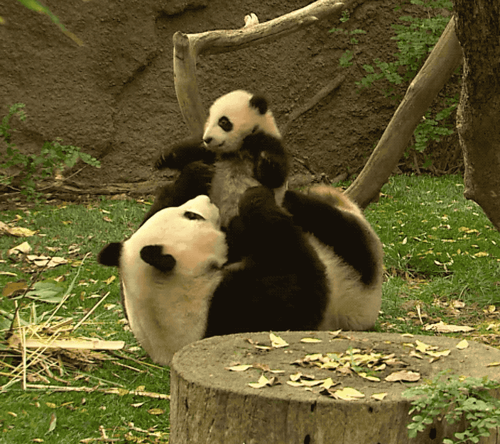
Get it done
Happy Developers
Find Bugs Now
Faster Fixes

Slide 21
Resources
Code Maat – Adam Thornhill - github.com/adamtornhill/code-maat Git Log Docs - git-scm.com/docs/git-log Guava - github.com/google/guava YAMCS - www.yamcs.org/
- github.com/yamcs/yamcs
- sonarcloud.io/dashboard?id=org.yamcs%3Ayamcs, Sonar API - sonarcloud.io/web_api
Scripts and Slides - github.com/helenwa/talks/tree/master/2019_09_06-ShipItCon

Slide 22
QUESTIONS
?

Slide 23
Helen Wallace
@helenFindsLife
@Work_at_Murex
@ShipItCon

